Slide 1
TESLA Stock Price Prediction
Business Forecasting, Final Project
Presented By:
Parth Patel – 190000189
Urvi Vipani – 189007018
Dipti Kalathiya - 188009829

Slide 2
CONTENT
Introduction
Objective
Dataset Description
Forecasting Methods
Conclusion
Q & A

Slide 3
INTRODUCTION

Slide 4
Tesla, Inc. (formerly Tesla Motors, Inc.) is an American automotive and energy company based in Palo Alto, California.
The company was co-founded by Elon Musk, J.B. Straubel, and Ian Wright.
The company received funding at various levels and eventually launched its IPO on NASDAQ with 13,300,000 shares each priced at $17.
The company recognizes itself as an independent automaker, aimed at eventually offering electric cars at affordable price.
Apart from the electric cars ( Model S, Model X, and Model 3) the tesla also sells Powerwall and Powerpack batteries, solar panels, solar roof tiles and some related products.
Elon Musk serves as Chairman & Chief Executive Officer, although he was asked to step down from chairman position by the SEC after recent controversy.

Slide 5
Objective

Slide 6
For any investor, stock prices play an important role in decision making to buy the stock or not.
We have tried and forecasted the stock price of tesla using around 1300 past observations of stock details.
This kind of analysis and forecast results help understanding and prepare in advance to either buy or sell the shares.

Slide 7
DATASET DESCRIPTION

Slide 8
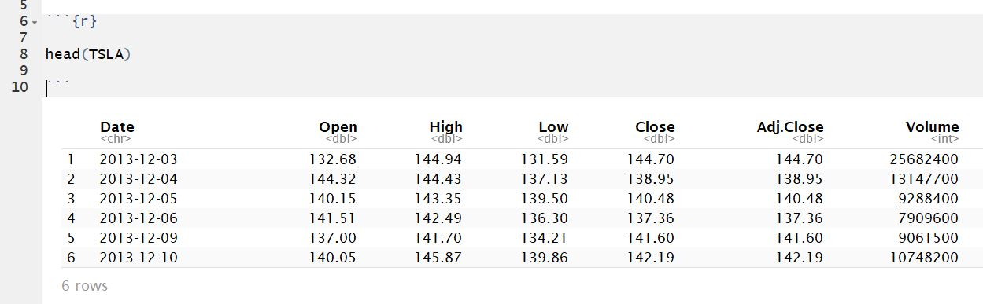
We will start we looking at how the dataset looks like.
We will use the head() function here just to glimpse of few initial rows of data entry and what attributes apart from closing price are mentioned in the dataset.

Slide 9
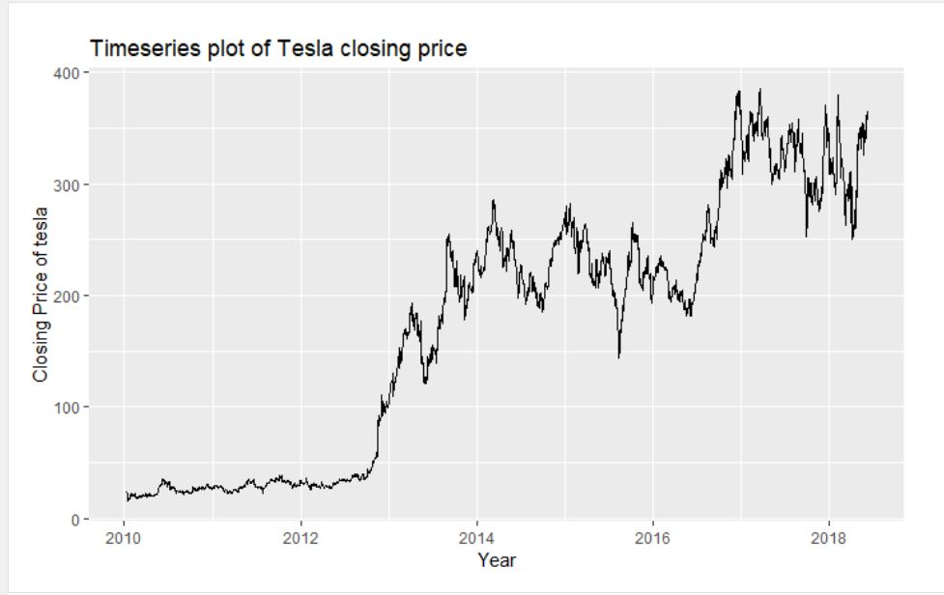

Slide 10
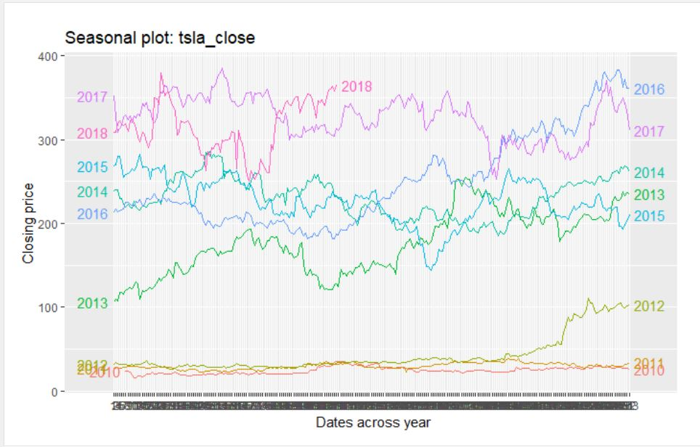

Slide 11
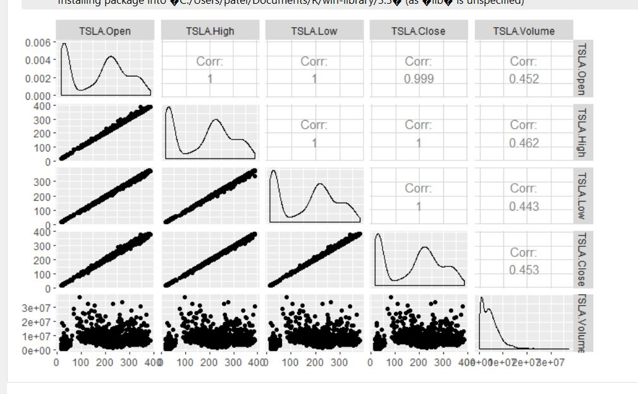

Slide 12
DATA ANALYSIS & FORECASTING
Forecasting Methods/Models used:
Average, Naïve, & Seasonal Naïve method
Linear Regression
Trend cycle plotting
STL decomposition
AR(p) model
MA(q) model

Slide 13
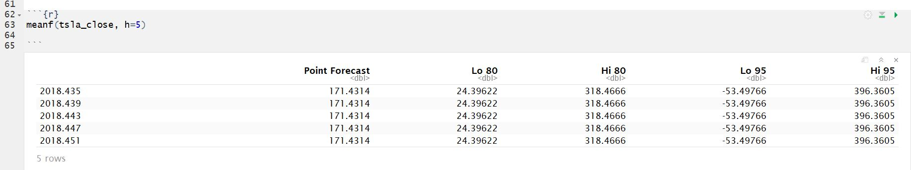
Average Method
In this method we forecast the future values of the variable using the average or mean of the historical data.

Slide 14
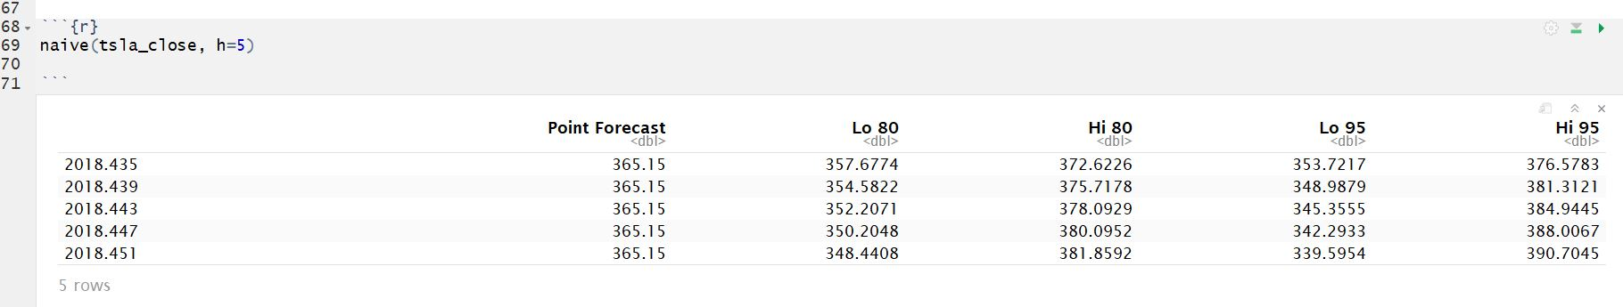
Naïve method
In this method, the forecast are simply the same as last observed value or observation.

Slide 15
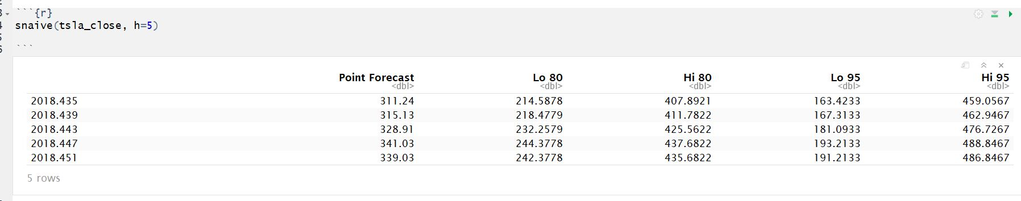
Seasonal naïve method
This method is similar to the Naïve method but simply just forecasts the last value of the same season from last year.

Slide 16
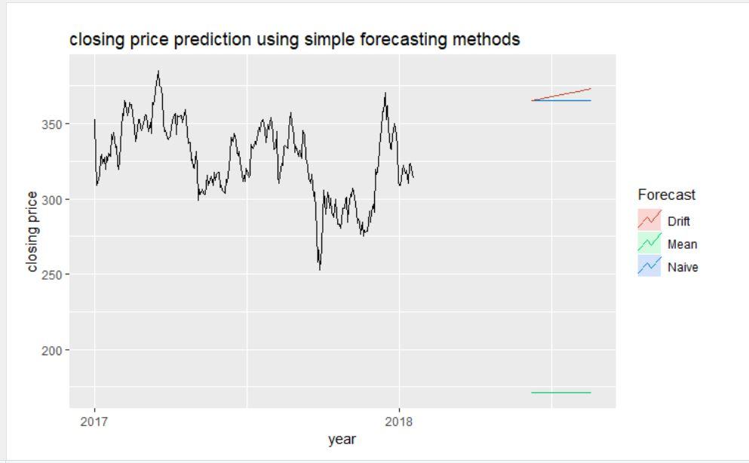

Slide 17
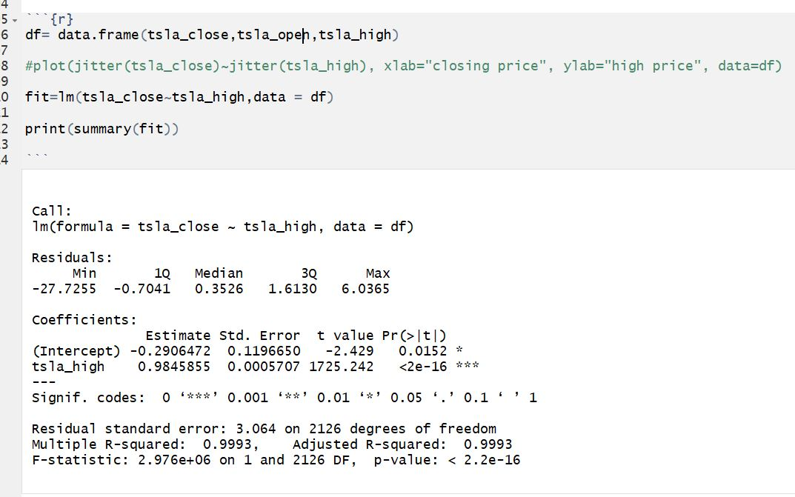
Simple linear regression

Slide 18
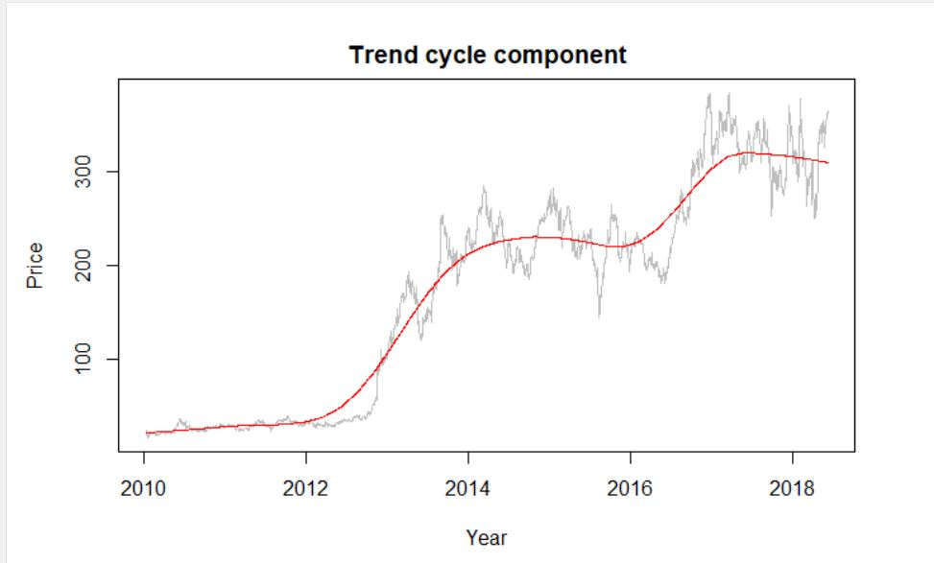
Trend cycle component

Slide 19
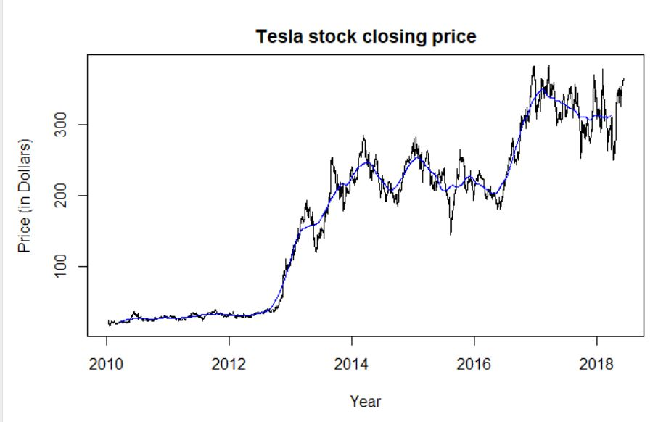
The moving Average plots

Slide 20
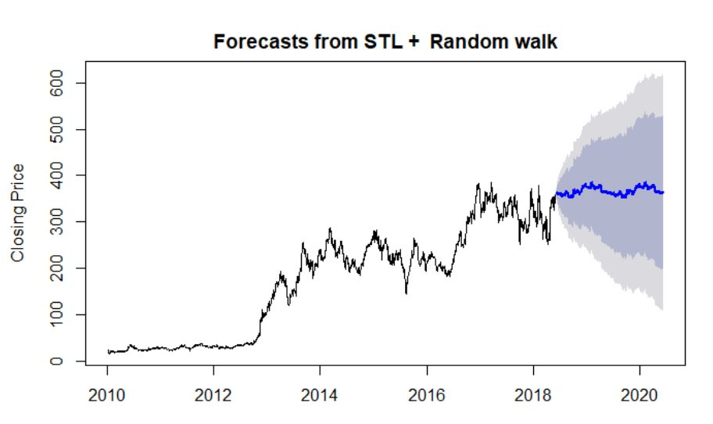
STL decomposition

Slide 21
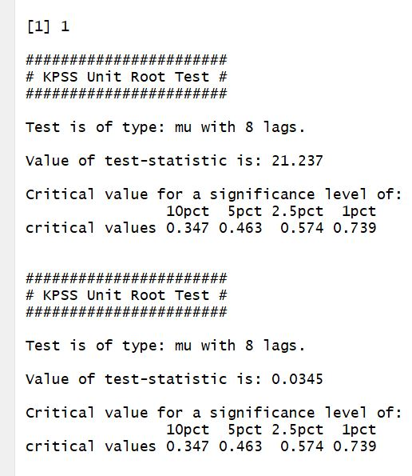
Stationarity tests

Slide 22
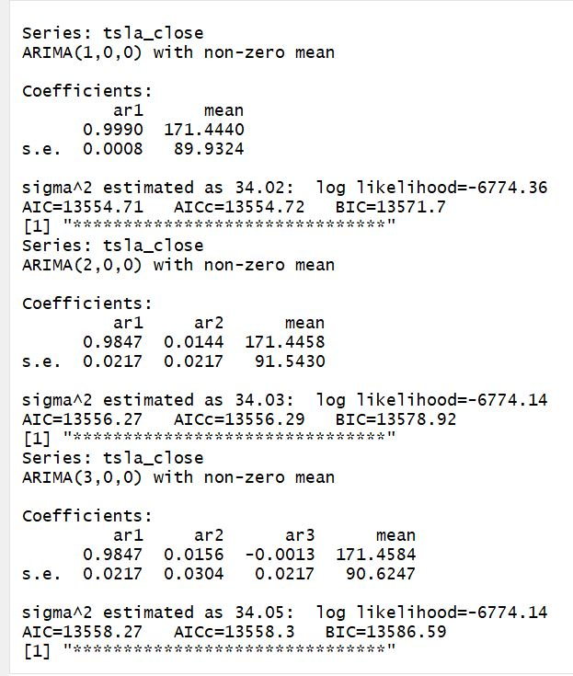
AR(p) model

Slide 23
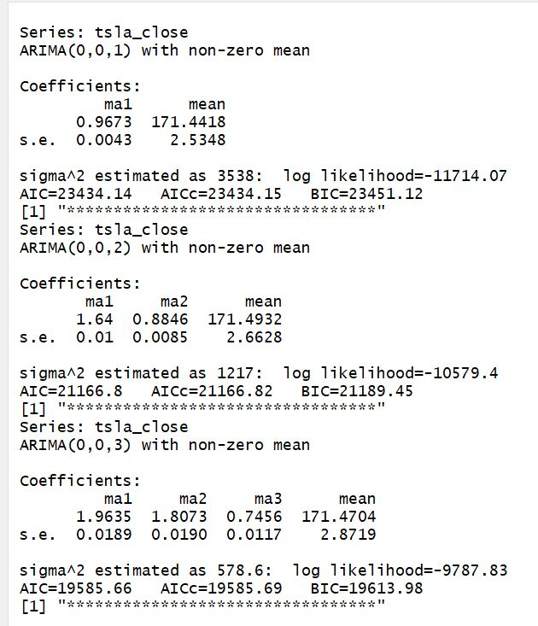
Ma(q) model

Slide 24
Conclusion
The data we took of the Tesla INC. Contained trend which we were able to realize.
The data was also not stationary.
Some forecast methods would be inappropriate to use here considering the amount data points we had in our dataset.
Some forecast methods were good upto certain extent but they lack some or other condition that makes them miss certain aspects of the forecast.

Slide 25
Thank You!
Q&A

